Slide 1
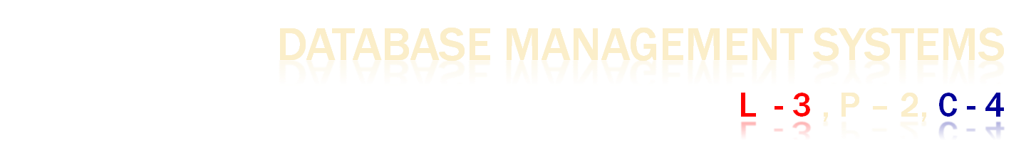
15IT302J

Slide 2

DBMS
Examples
Purpose of DB
File Processing System
View of Data
Level of Abstraction
Instances and Schema
Notes:
2

Slide 3
DATABASE MANAGEMENT SYSTEM (DBMS)
Database
Collection of data, Primary Goal : store and retrieve database information that is both convenient and efficient.
DBMS contains information about a particular enterprise
Collection of interrelated data
Set of programs to access the data
Database Applications:
Banking: transactions
Airlines: reservations, schedules
Universities: registration, grades
Sales: customers, products, purchases
Online retailers: order tracking, customized recommendations
Manufacturing: production, inventory, orders, supply chain
Human resources: employee records, salaries, tax deductions
Databases can be very large.
Databases touch all aspects of our lives
Notes:
3

Slide 4
UNIVERSITY DATABASE EXAMPLE
Application program examples
Add new students, instructors, and courses
Register students for courses, and generate class rosters
Assign grades to students, compute grade point averages (GPA) and generate transcripts
In the early days, database applications were built directly on top of file systems
Notes:
4

Slide 5

In need of handling computerized management of commercial data.
Allow users to manipulate the information.
Have to be written to handle new rules
Acquires more files and more application programs
Notes:
5

Slide 6
DRAWBACKS OF USING FILE SYSTEMS TO STORE DATA
Data redundancy and inconsistency
Multiple file formats, duplication of information in different files
Difficulty in accessing data
Need to write a new program to carry out each new task
Data isolation
Multiple files and formats
Integrity problems
Integrity constraints (e.g., account balance > 0) become “buried” in program code rather than being stated explicitly
Hard to add new constraints or change existing ones
Notes:
6

Slide 7
DRAWBACKS OF USING FILE SYSTEMS TO STORE DATA (CONT.)
Atomicity of updates
Failures may leave database in an inconsistent state with partial updates carried out
Example: Transfer of funds from one account to another should either complete or not happen at all
Concurrent access by multiple users
Concurrent access needed for performance
Uncontrolled concurrent accesses can lead to inconsistencies
Example: Two people reading a balance (say 100) and updating it by withdrawing money (say 50 each) at the same time
Security problems
Hard to provide user access to some, but not all, data
Database systems offer solutions to all the above problems
Notes:
7

Slide 8

A major purpose of a database system is to provide users with an abstract view of the data.
The system hides certain details of how the data are stored and maintained.
Data Abstraction
Physical Level
Logical Level
View Level

Slide 9
LEVELS OF ABSTRACTION
Physical level: describes how a record (e.g., instructor) is stored.
Logical level: describes data stored in database, and the relationships among the data.
Implementation of the simple structures at the logical level may involve complex physical-level structures, the user of the logical level does not need to be aware of this complexity - physical data independence.
View level: application programs hide details of data types. Views can also hide information (such as an employee’s salary) for security purposes.
Notes:
9

Slide 10
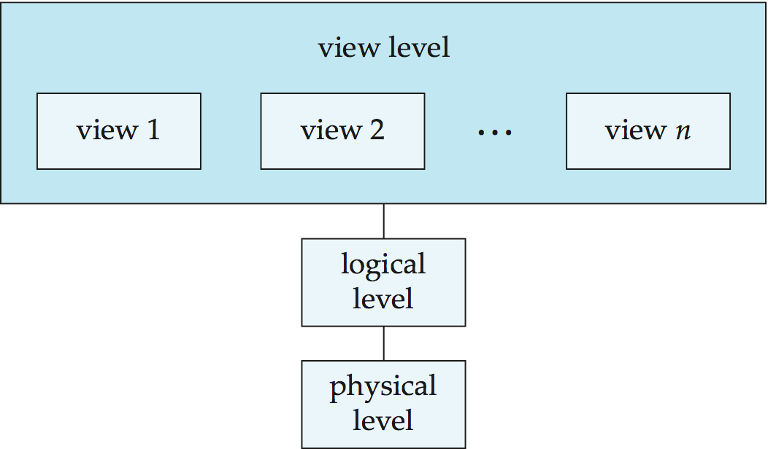
VIEW OF DATA
An architecture for a database system
Notes:
10

Slide 11

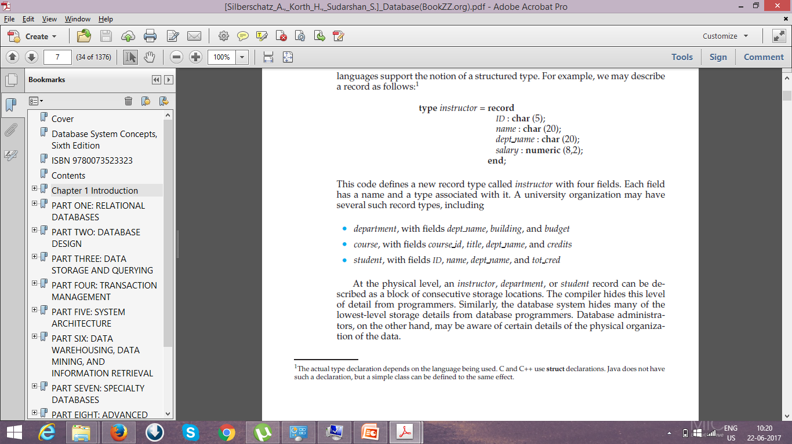
Record –
INSTRUCTOR with fields ID, NAME, DEPT_NAME, SALARY.
DEPARTMENT with fields DEPT_NAME, BUILDING, BUDGET
COURSE with fields COURSE_ID, TITLE, DEPT_NAME, CREDITS
STUDENT with fields ID, NAME, DEPT_NAME, AND TOT_CRED
Notes:
11

Slide 12
INSTANCES AND SCHEMAS
Instances - collection of information stored in the database at a particular moment
Schema - The overall design of the database
Logical Schema – the overall logical structure of the database
Example: The database consists of information about a set of customers and accounts in a bank and their relationship
Physical schema– the overall physical structure of the database
Instance – the actual content of the database at a particular point in time
Physical Data Independence – the ability to modify the physical schema without changing the logical schema
Applications depend on the logical schema
In general, the interfaces between the various levels and components should be well defined so that changes in some parts do not seriously influence others.
Notes:
12

Slide 13

In the physical level,
an instructor, department, or student record - block of consecutive storage locations – KNOWN by Database Administrator.
The compiler hides this level of detail from programmers.
In the logical level,
each such record is described by a type definition and their interrelationship among record types.
Programmers work at this level of abstraction using a programming language.
In the view level,
Application programs that hide details of the data types from users.
Several views of the database are defined, and a database user sees some or all of these views.

Slide 14

End of Session 1

Slide 15

Session 2

Slide 16

Data model
Relational Model
ER model
Object based Data Model
Semistructure Model
Network Model
Hierarchical Model
Database Language

Slide 17
DATA MODELS
A collection of conceptual tools for describing
Data
Data relationships
Data semantics
Data constraints
Relational model
Entity-Relationship data model (mainly for database design)
Object-based data models (Object-oriented and Object-relational)
Semistructured data model (XML)
Other older models:
Network model
Hierarchical model
Notes:
17

Slide 18

Model uses a collection of tables to represent both data and the relationships among those data.
Each table has multiple columns and each column has a unique name.
The relational model is an example of a record-based model.
Record-based models are so named because the database is structured in fixed-format records
of several types.
Each table contains records of a particular type. Each record type defines a fixed number of fields, or attributes.
The columns of the table correspond to the attributes of the record type.
It is not hard to see how tables may be stored in files.
The relational model hides such low-level implementation details from database developers and users.
Data Definition Language
Data Manipulation Language
Application Program

Slide 19

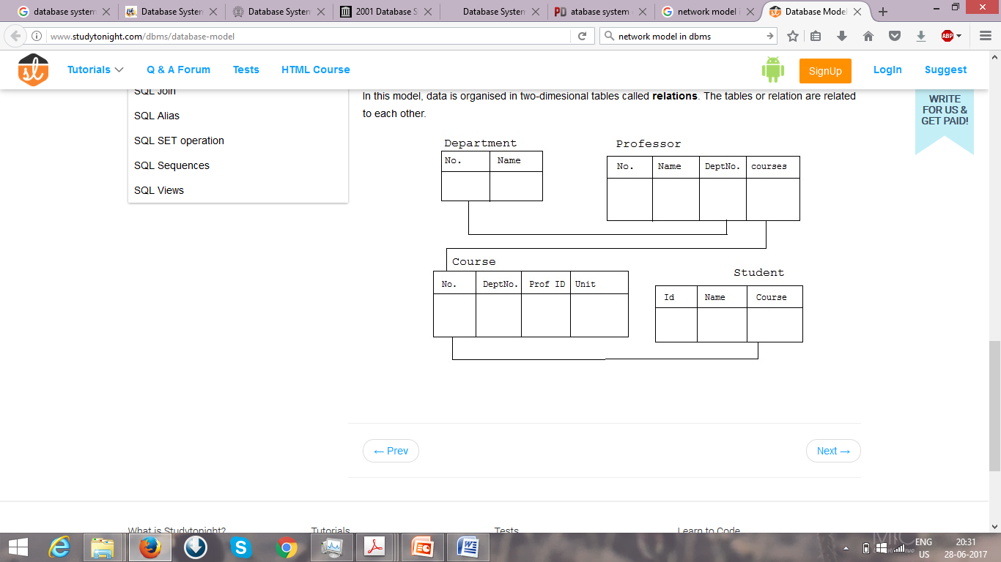
The entity-relationship (E-R) data model uses
Entities - a collection of basic objects - “thing” or “object” in the real world
Relationships among these objects.

Slide 20

Object-oriented programming (especially in Java, C++, or C#) has become the dominant software-development methodology.
Extending the E-R model
Encapsulation,
Methods (functions),
Object identity.
Combines features of the object-oriented data model and relational data model.

Slide 21

Specification of data where individual data items of the same type may have different sets of attributes.
Every data item of a particular type must have the same set of attributes.
The Extensible Markup Language (XML) is widely used to represent semistructured data.
Defined by the WWW Consortium (W3C)
Originally intended as a document markup language not a database language
The ability to specify new tags, and to create nested tag structures made XML a great way to exchange data, not just documents
XML has become the basis for all new generation data interchange formats.
A wide variety of tools is available for parsing, browsing and querying XML documents/data

Slide 22

Hierarchical model is a data model which uses the tree as its basic structure.
A data structure diagram for a tree representing the STUDENT, FACULTY and CLASS.
The root node chosen is faculty, CLASS as a child of faculty and STUDENT as a child of class.
The cardinality between CLASS and FACULTY is one to many cardinality as a FACULTY teaches one or more CLASS.
The cardinality between a CLASS and a STUDENT is also one to many cardinality because a CLASS has many STUDENTS.

Slide 23
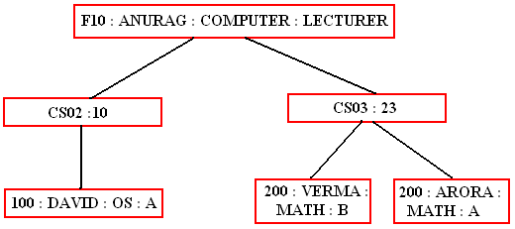

Slide 24

The Network model replaces the hierarchical tree with a graph thus allowing more general connections among the nodes.
The main difference of the network model from the hierarchical model, is its ability to handle many to many (N:N) relations. In other words, it allows a record to have more than one parent.
Suppose an professor works in department, courses and students.
The strict hierarchical arrangement is not possible here and the tree becomes a more generalized graph - a network.
The network model was evolved to specifically handle non-hierarchical relationships. As shown below data can belong to more than one parent. Note that there are lateral connections as well as top-down connections.
A network structure thus allows 1:1 (one: one), l: M (one: many), M: M (many: many) relationships among entities.

Slide 25
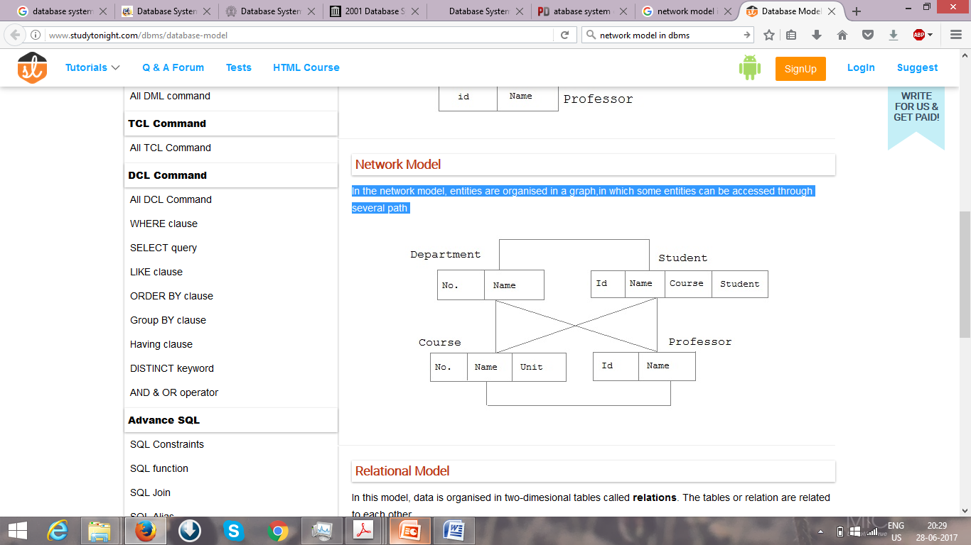

Slide 26
End of Session 2

Slide 27

Session 3

Slide 28

Data-Definition Lanaguage (DDL) – express database schema by a set of definitions.
For Instance,
Create table account (acc_no number(5), balance integer)
Data Dictionary or Data Directory – contains metadata (data about data).
DDL compiler generates a set of table templates stored in a data dictionary
Data dictionary contains metadata (i.e., data about data)
Database schema
Integrity constraints
Primary key (ID uniquely identifies instructors)
Authorization
Who can access what
Data storage and definition Language – storage and access methods used by DB system by special type of DDL.

Slide 29
DATABASE LANGUAGE CONTD
DML - specify a database schema by a set of definitions
Language for accessing and manipulating the data organized by the appropriate data model
Retrieval of information stored in the database
Insertion of new information into the database
Deletion of information from the database
Modification of information stored in the database
Two classes of languages
Procedural DMLs - a user to specify what data are needed and how to get those data.
Declarative DMLs (nonprocedural DMLs) - a user to specify what data are needed without specifying how to get those data.
Notes:
29

Slide 30

Database Access from Application Programs
Programs that are used to interact with the database
Host language – Cobol, C, C++, Java
Two ways to do this
Application program interface – used to send DML and DDL statements to the DB, retrieve the results
Open Database Connectivity ODBC
Java Database Connectivity JDBC
Embed DML within the host language program – DML precompiler.

Slide 31

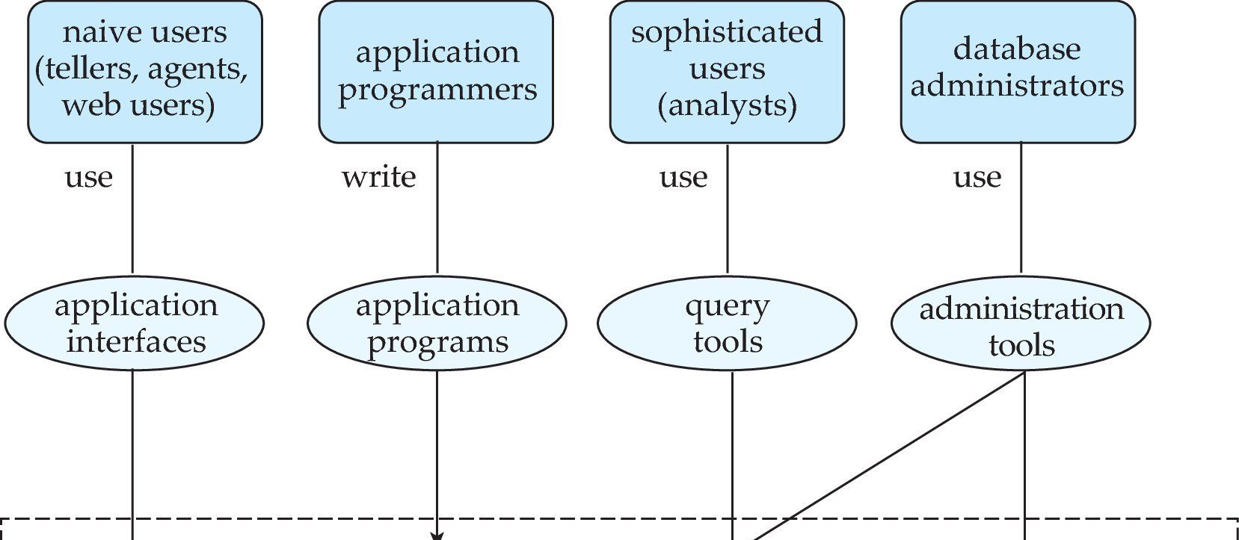

Slide 32

Goal – Retrieve information and store new information in DB.
Database users and User Interfaces
Naive users - unsophisticated users - interact with the system through previously application programs.
Application programmers - computer professionals write application programs to develop user interfaces
Sophisticated users - interact with the system without writing programs - access using a database query language or data analysis software tools
Specialized users - sophisticated users who write specialized database applications

Slide 33
Database Administrators
Have central control of both the data and the programs - person who control over the system is called a database administrator (DBA).
Functions of a DBA
Schema definition - DBA creates database schema by a set of data definition statements in the DDL.
Storage structure and access-method definition.
Schema and physical-organization modification -alter the physical organization to improve performance.
Granting of authorization for data access - By granting different types of authorization, the database administrator can regulate which parts of the database various users can access.
Routine maintenance. Examples of the database administrator’s routine maintenance activities are:
Periodically backing up the database
Ensuring that enough free disk space
Monitoring jobs running on the database
Ensuring that performance

Slide 34
End of Session 3

Slide 35

Session 4

Slide 36

Database Architecture
Database System Structure
History of Database

Slide 37

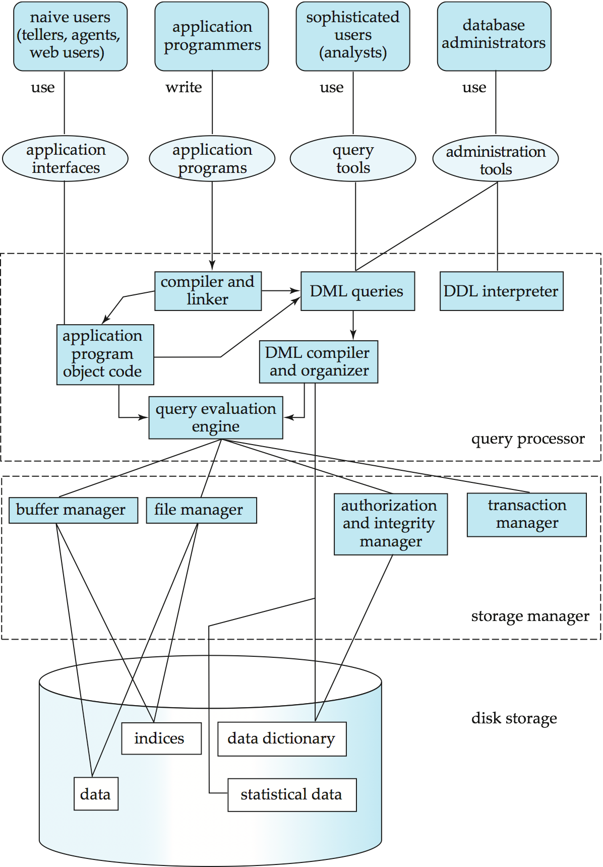

Slide 38
STORAGE MANAGEMENT
Storage manager is a program module that provides the interface between the low-level data stored in the database and the application programs and queries submitted to the system.
The storage manager is responsible to the following tasks:
Interaction with the OS file manager
Efficient storing, retrieving and updating of data
Issues:
Storage access
File organization
Indexing and hashing
Notes:
38

Slide 39

The storage manager components include:
Authorization and integrity manager – tests integrity constraints and checks the authority of users to access data.
Transaction manager, ensures DB in a consistent state even in system failures and in concurrent transaction executions
File manager - manages disk storage and the data structures
Buffer manager – fetch data from disk storage into main memory
Data Structures Implemented
Data files - store the database itself.
Data dictionary -stores metadata about the structure of the database,
Indices – provide fast access to data items

Slide 40
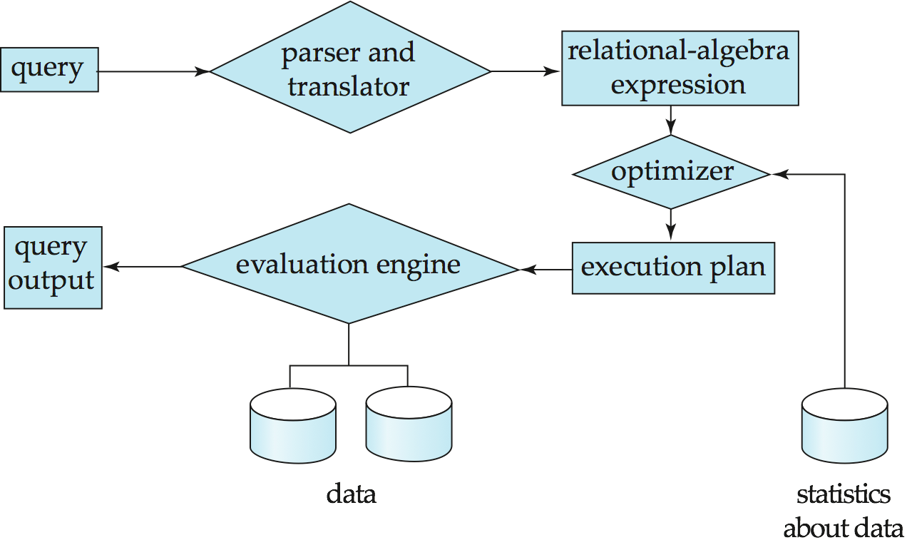
QUERY PROCESSING
1. Parsing and translation
2. Optimization
3. Evaluation
Notes:
40

Slide 41
QUERY PROCESSING (CONT.)
Alternative ways of evaluating a given query
Equivalent expressions
Different algorithms for each operation
Cost difference between a good and a bad way of evaluating a query can be enormous
Need to estimate the cost of operations
Depends critically on statistical information about relations which the database must maintain
Need to estimate statistics for intermediate results to compute cost of complex expressions
Notes:
41

Slide 42
TRANSACTION MANAGEMENT
What if the system fails?
What if more than one user is concurrently updating the same data?
A transaction is a collection of operations that performs a single logical function in a database application
Transaction-management component ensures that the database remains in a consistent (correct) state despite system failures (e.g., power failures and operating system crashes) and transaction failures.
Concurrency-control manager controls the interaction among the concurrent transactions, to ensure the consistency of the database.
Notes:
42

Slide 43
DATABASE ARCHITECTURE
The architecture of a database systems is greatly influenced by
the underlying computer system on which the database is running:
Centralized
Client-server
Parallel (multi-processor)
Distributed
Notes:
43

Slide 44

Database systems can be centralized, or client-server, where one server machine executes work on behalf of multiple client machines.
Database systems can also be designed to exploit parallel computer architectures. Distributed databases span multiple geographically separated machines.
Structure of Modern Computer System.
Query processing using parallel processing
Distributed Database
Ensure atomicity & concurrency control of transactions that execute at multiple sites
Distributed query processing and directory systems
Database applications are usually partitioned into two or three parts,
Two-tier architecture, the application resides at the client machine,
Three-tier architecture, the client machine acts as front end and no direct database calls.

Slide 45
HISTORY OF DATABASE SYSTEMS
1950s and early 1960s:
Data processing using magnetic tapes for storage
Tapes provided only sequential access
Punched cards for input
Late 1960s and 1970s:
Hard disks allowed direct access to data
Network and hierarchical data models in widespread use
Ted Codd defines the relational data model
Would win the ACM Turing Award for this work
IBM Research begins System R prototype
UC Berkeley begins Ingres prototype
High-performance (for the era) transaction processing
Notes:
45

Slide 46
HISTORY (CONT.)
1980s:
Research relational prototypes evolve into commercial systems
SQL becomes industrial standard
Parallel and distributed database systems
Object-oriented database systems
1990s:
Large decision support and data-mining applications
Large multi-terabyte data warehouses
Emergence of Web commerce
Early 2000s:
XML and XQuery standards
Automated database administration
Later 2000s:
Giant data storage systems
Google BigTable, Yahoo PNuts, Amazon, ..
Notes:
46

Slide 47
End of Session 4

Slide 48

Session 5

Slide 49
ER model
Entity Sets
Attribute Type
Relationship Sets
Constraints
Keys

Slide 50

Represents the logical structure of DB, serve as semantic data model
Useful in mapping the meaning and interactions of real world onto conceptual schema.
Basic concepts
Entity Sets
Relationship sets
Constraints
Keys

Slide 51

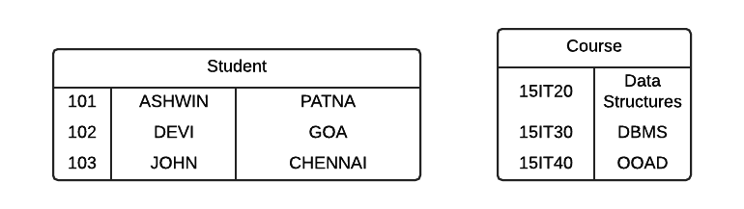
Entity: A thing or object in real world.
Ex: Each student in a department is an entity.
Stud Id= 101 identify a unique person in the department.
Entity Set: set of entities of same type.
Ex: set of all student details - student entity set.
Attributes: descriptive properties possessed by each member of entity set
Ex: Stud_id, Stud_name, City
101 is value of the attribute Stud_id
Domain / Value set: set of permitted values for each attributes.
Ex: Stud_name is set of all strings of certain length

Slide 52

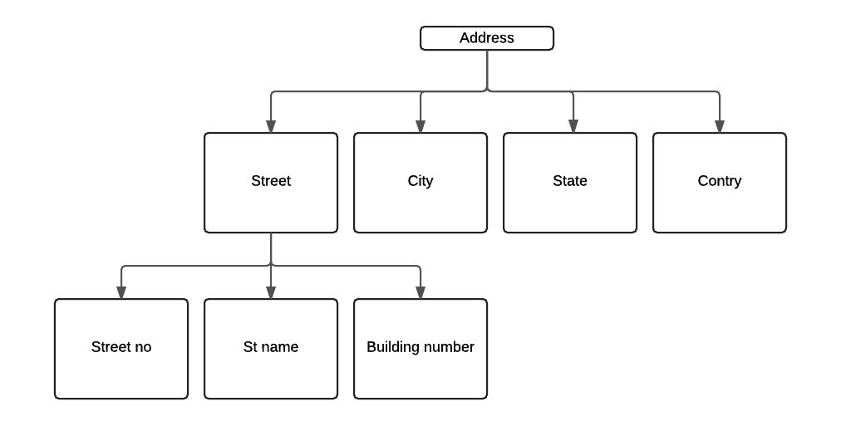
Simple attribute – attributes cant be divided into subparts.
Ex: Firstname, MiddleName, LastName of students
Composite attribute – attributes can be divided into subparts
Ex: StudName can be divided into Firstname, LastName
Single-valued attribute – have single value for particular entity
Ex: StudId
Multivalued attribute – can have more than single value for a particular entity
Ex: StudPhoneNo.
Derived attribute – value can be derived from value of other related attribute
Ex: Value of Age attribute can be derived from DOB attribute
Notes:
52

Slide 53

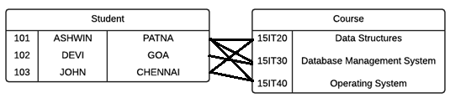
Relationship : association among entities.
Ex: Relation between Devi and DBMS.
Relationship set: set of relationships of same type.
Ex Relationship set Coursestaken
Relationship Instance: association between entities that is modeled
Ex: 101 from Goa taken DBMS.
Descriptive Attribute – attribute of relationship set
Ex: DateofEnrollment in relationship set Coursestaken
Participate: An entity E1,E2 ..En Participate in Relationship set R.
Entity Role: Function that entity plays in relationship
Recursive Relationship set
Binary Relationship set

Slide 54

Mapping Cardinalities
One to One
One to Many
Many to One
Many to Many
Participation Constraints
Total
Partial

Slide 55
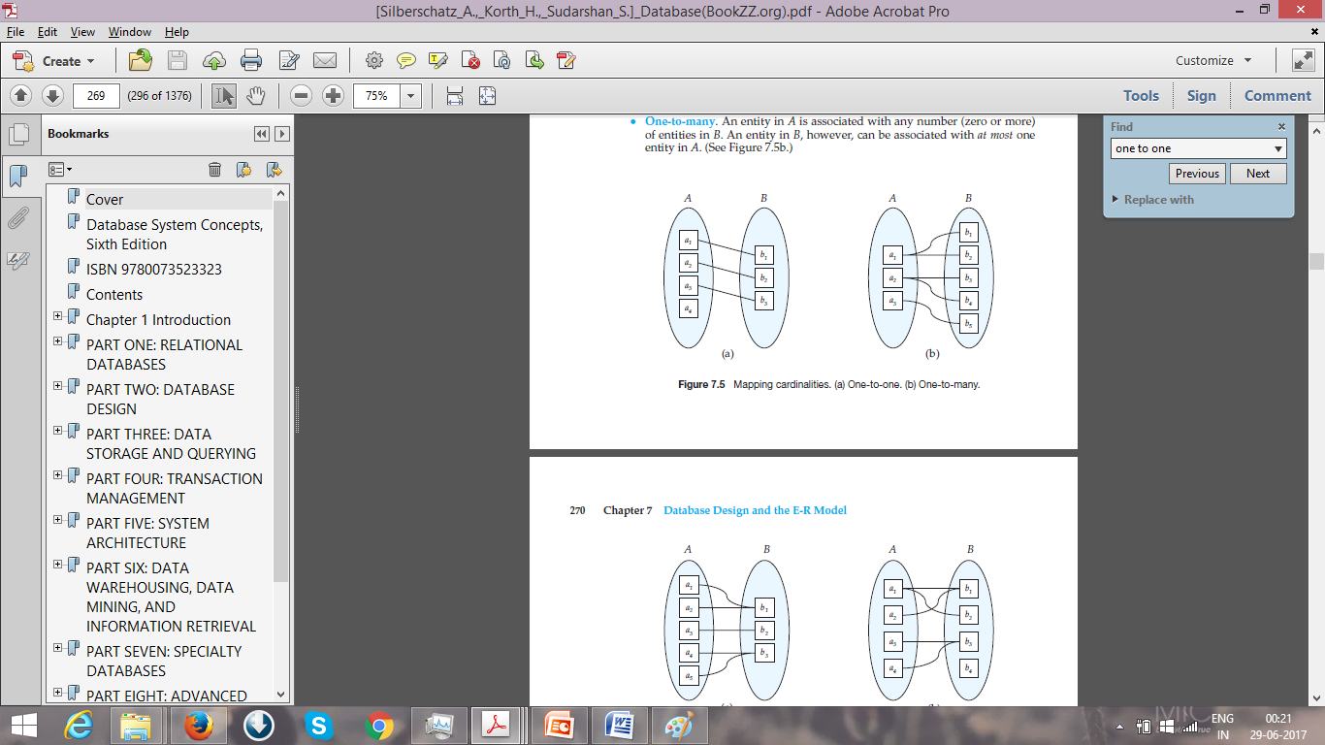

1:1 1:M M:1 M:M
B Total with A
A Partial with B

Slide 56

Keys – used to identify a set of attributes that can identify entities from each others.
Entity sets
Super Key: set of one or more attributes (collectively) identify uniquely an entity in entity set. Ex: <StudId>, <StudName,DOB>, <StudId,City>, <StudId, City, State>
Candidate keys: a superkey which has no propersubset or minimal superkey. Ex: StudId
Primary Key: DB designer uses a candidate key for identification of entity uniquiely. Ex: StudId
Relationship sets
Relationship sets contains Primary key of all entity set involves in relationship

Slide 57
E-R Diagrams

Slide 58
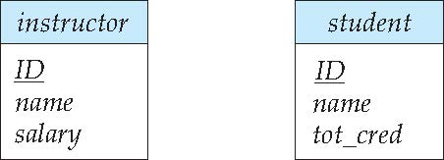
Entity Sets
Entities can be represented graphically as follows:
Rectangles represent entity sets.
Attributes listed inside entity rectangle
Underline indicates primary key attributes

Slide 59
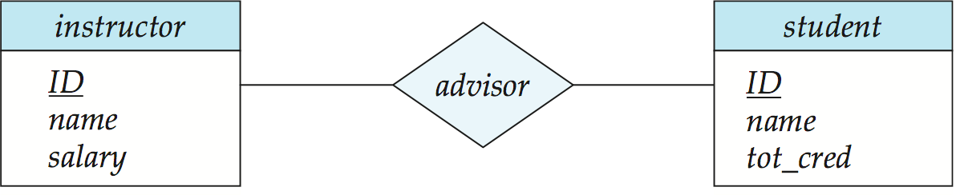
Relationship Sets
Diamonds represent relationship sets.

Slide 60
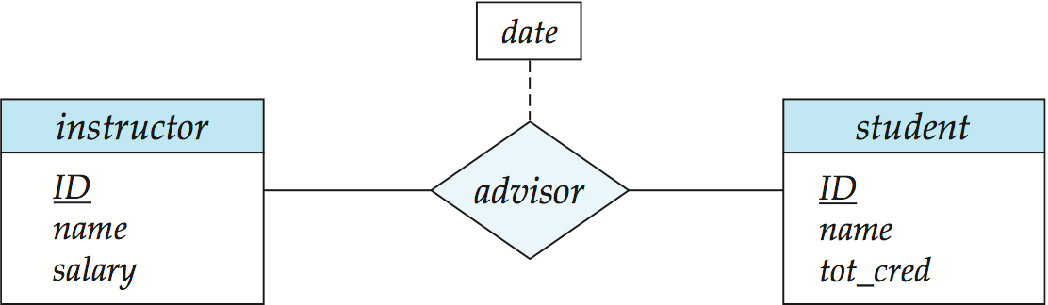
Relationship Sets with Attributes

Slide 61
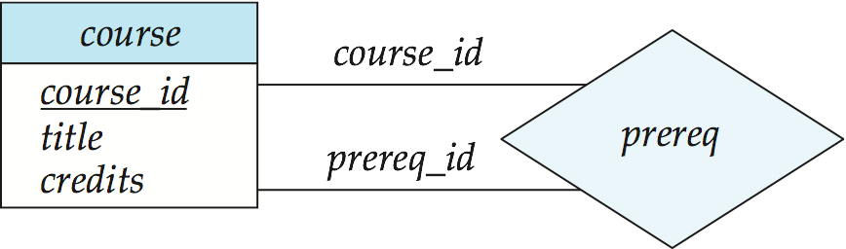
Roles
Entity sets of a relationship need not be distinct
Each occurrence of an entity set plays a “role” in the relationship
The labels “course_id” and “prereq_id” are called roles.

Slide 62
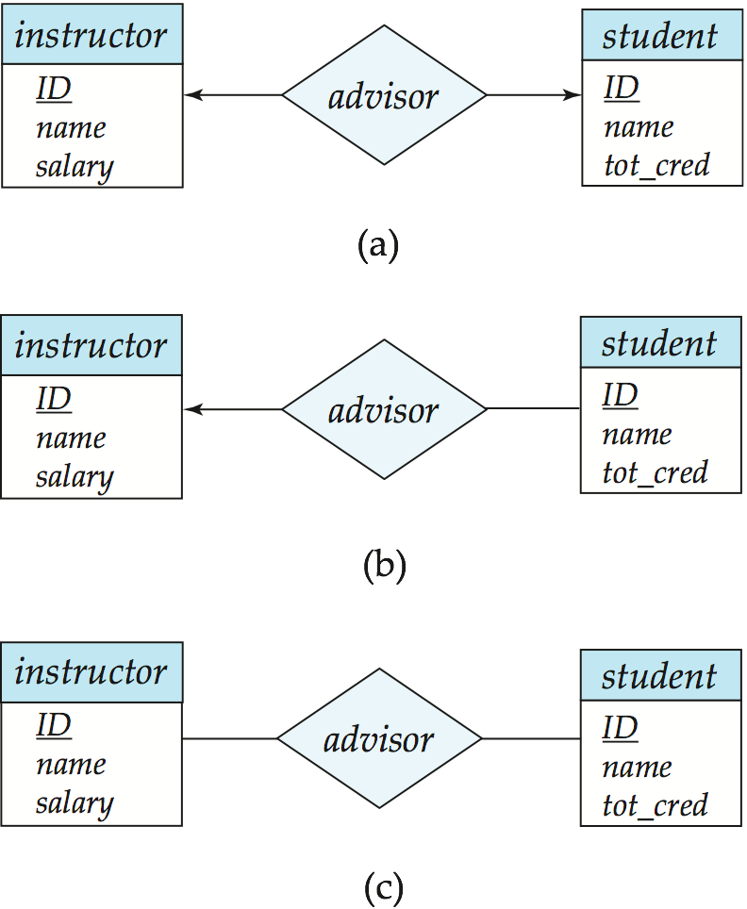
Cardinality Constraints
We express cardinality constraints by drawing either a directed line (→), signifying “one,” or an undirected line (—), signifying “many,” between the relationship set and the entity set.
One-to-one relationship between an instructor and a student :
A student is associated with at most one instructor via the relationship advisor
A student is associated with at most one department via stud_dept

Slide 63
One-to-Many Relationship
one-to-many relationship between an instructor and a student
an instructor is associated with several (including 0) students via advisor
a student is associated with at most one instructor via advisor,

Slide 64
Many-to-One Relationships
In a many-to-one relationship between an instructor and a student,
an instructor is associated with at most one student via advisor,
and a student is associated with several (including 0) instructors via advisor

Slide 65
Many-to-Many Relationship
An instructor is associated with several (possibly 0) students via advisor
A student is associated with several (possibly 0) instructors via advisor

Slide 66
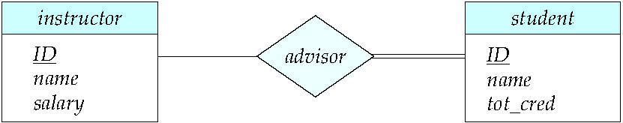
Total and Partial Participation
Total participation (indicated by double line): every entity in the entity set participates in at least one relationship in the relationship set
participation of student in advisor relation is total
every student must have an associated instructor
Partial participation: some entities may not participate in any relationship in the relationship set
Example: participation of instructor in advisor is partial

Slide 67
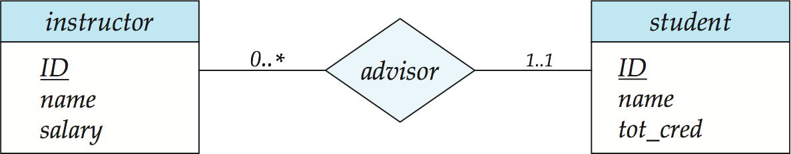
Notation for Expressing More Complex Constraints
A line may have an associated minimum and maximum cardinality, shown in the form l..h, where l is the minimum and h the maximum cardinality
A minimum value of 1 indicates total participation.
A maximum value of 1 indicates that the entity participates in at most one relationship
A maximum value of * indicates no limit.
Instructor can advise 0 or more students. A student must have 1 advisor; cannot have multiple advisors

Slide 68
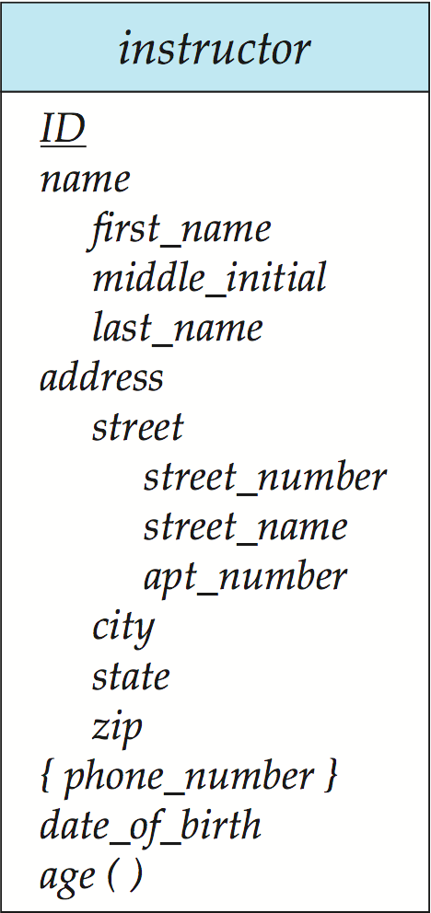
Notation to Express Entity with Complex Attributes

Slide 69
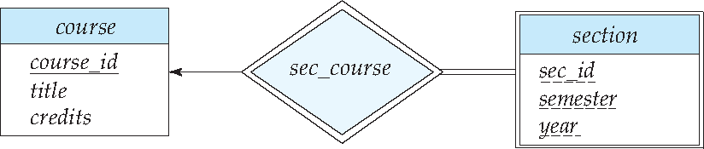
Expressing Weak Entity Sets
In E-R diagrams, a weak entity set is depicted via a double rectangle.
We underline the discriminator of a weak entity set with a dashed line.
The relationship set connecting the weak entity set to the identifying strong entity set is depicted by a double diamond.
Primary key for section – (course_id, sec_id, semester, year)

Slide 70
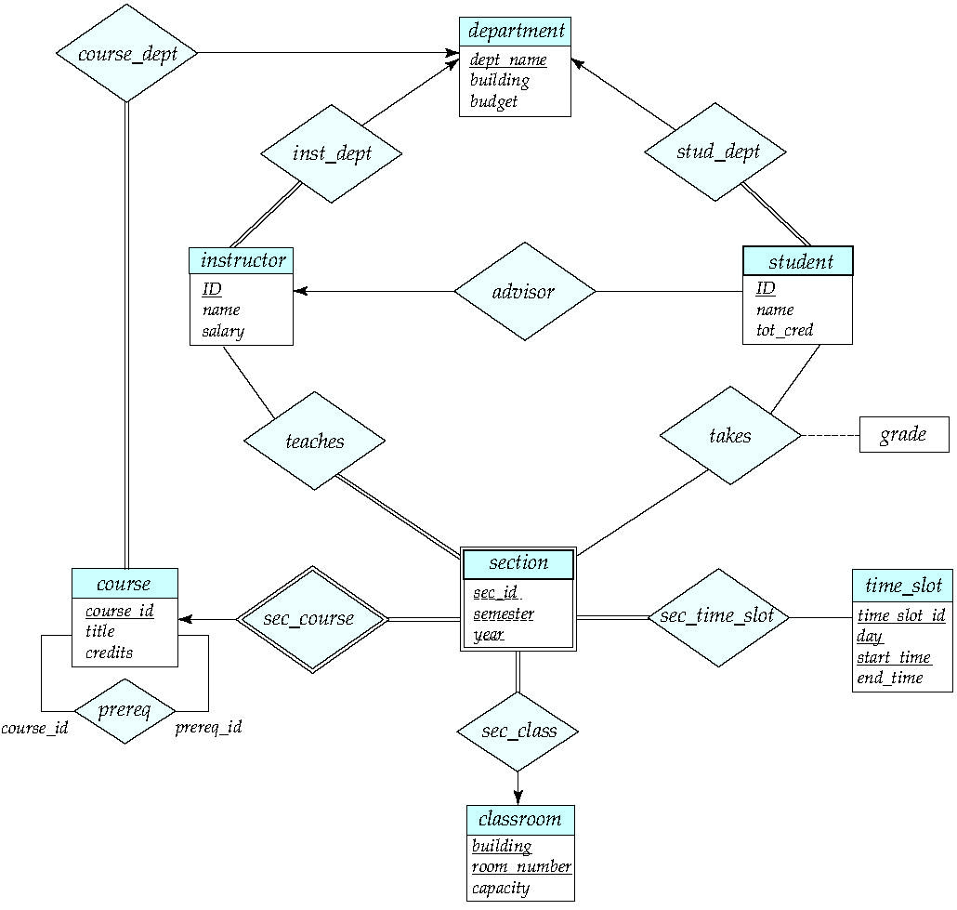
E-R Diagram for a University Enterprise

Slide 71
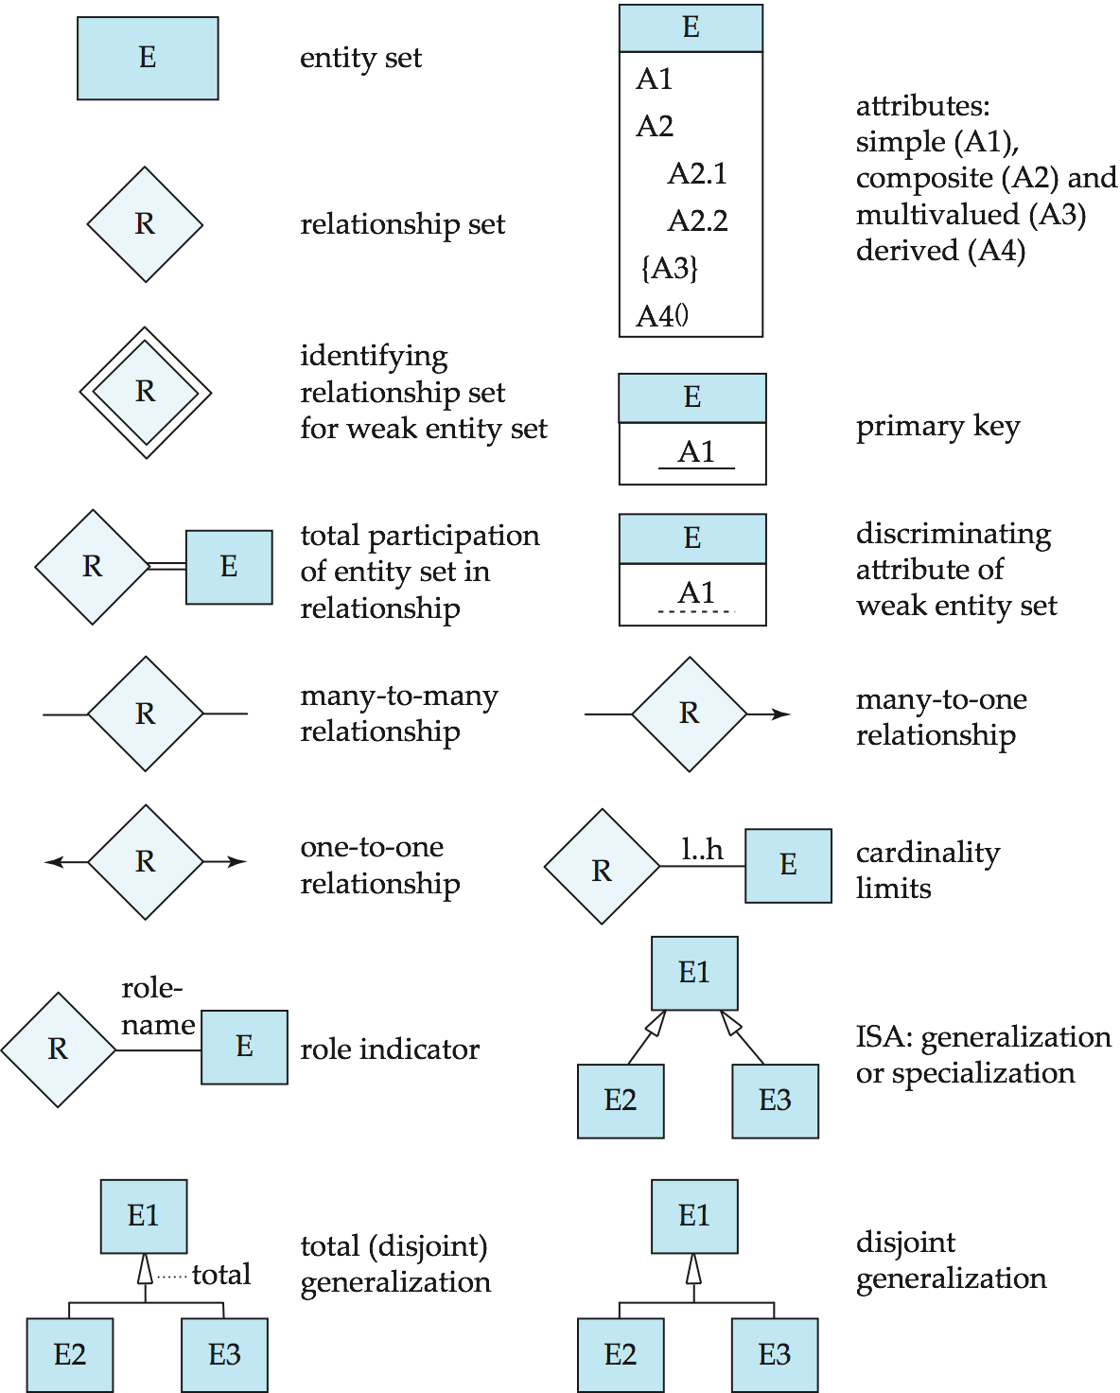
Summary of Symbols Used in E-R Notation

Slide 72
Symbols Used in E-R Notation (Cont.)

Slide 73
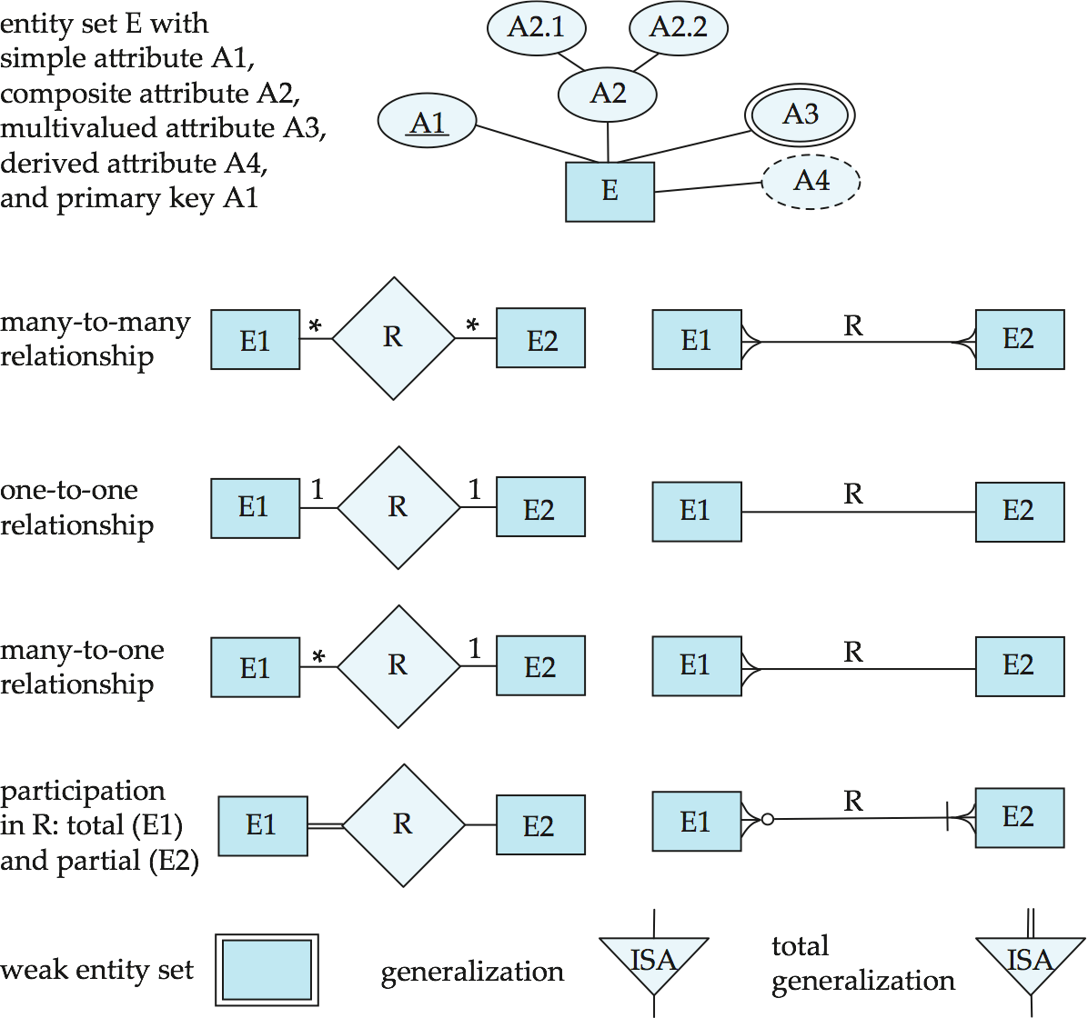
Alternative ER Notations
Chen, IDE1FX, …

Slide 74
Alternative ER Notations
Chen IDE1FX (Crows feet notation)

Slide 75
END OF UNIT 1
Session 5
Notes:
75

